Slide 1
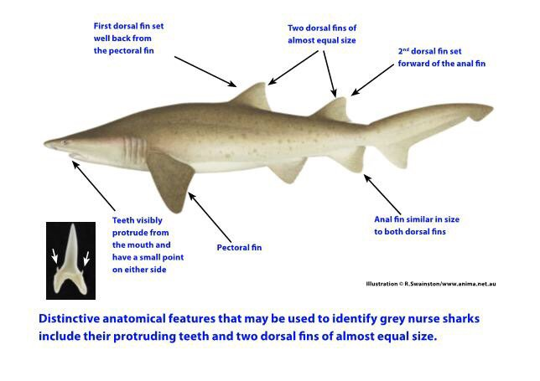
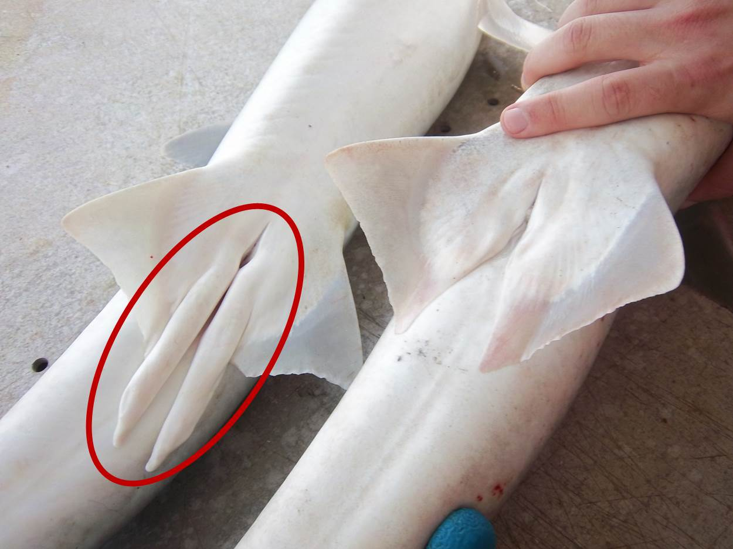
Grey Nurse Shark Census Data Collection
Date | Name of Diver / Email of Diver |  | Site Name (GPS if possible) | Water Temperature (Celsius) |  | Sea Depth (metres)
TOTAL Number of GNS
Number of Females
Number of Males
Number with Noticeable scarring?
Number with Fishing line / hook / trace?
Number of juveniles (less than 1m)
Number of sub-adults (1m – 2m)
Number of adults (2m+)
Number of pregnant females
Outline of GNS – morphological features. Identify areas of injuries in relation to fins and body position
Additional Comments
Right side = male (CLASPERS PRESENT)
Left side = female (NO CLASPERS PRESENT)
How to estimate length, a diver with fins is approximately = 2m the length of a shark against a ‘hypothetical’ diver to guestimate the length of the shark <1m, >1m, <2, >2m

